Slide 1
The European Location framework – taking INSPIRE to the next level
Emphasis on Cadastral Parcels, Buildings and Addresses
PCC meeting
dominique.laurent@ign.fr
12-13/05/2015

Slide 2
Programme
Expected benefits from ELF
    Data specification
    Data transformation
    Cascading services
    Extending the geographic coverage
    ELF GeoLocator
    ELF BaseMap
    ELF Cadastre
    Applications
Conclusions

Slide 3
Data specification

Slide 4
Data specification
ELF data specifications are INSPIRE based
What is the added value of ELF specification compared to INSPIRE ones?
    Extensions
      Adopt the Extended2D Building application schema *
    Clarification about levels of detail
* Only theoric use of Extended 2D Buildings as the logical application schema (XSD file) not yet published by JRC

Slide 5
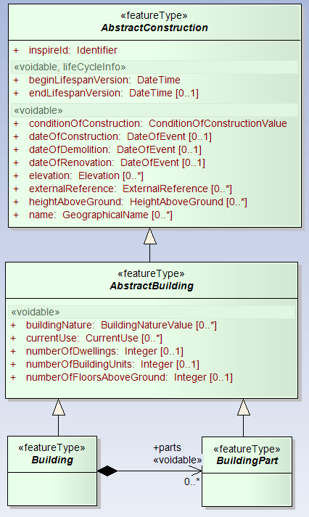
INSPIRE model BU (core)
Data specification: extension
Basic semantic:
Topographic attributes: height, nature (physical aspect), elevation, ..
Cadastral information : use, number of building units, …
Two options for geometry:
2D (or 2,5D)
3D

Slide 6
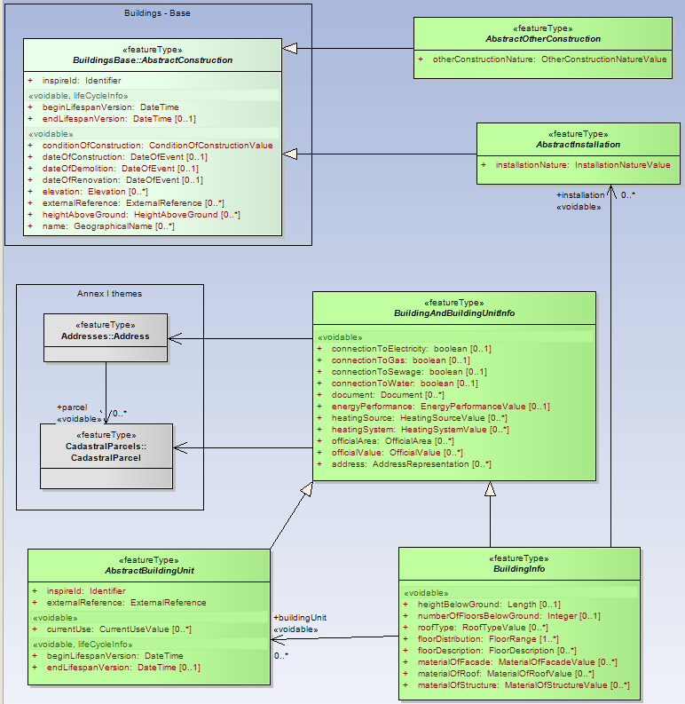
INSPIRE model BU (extended)
Data specification: extension
Semantic is enriched :
3 new feature types:
  OtherConstruction
  Installation
  BuildingUnit
Additional attributes
  Value, area, address
  Connection to networks
  Link to Address
  ….
Two options for geometry:
2D (or 2,5D)
3D

Slide 7
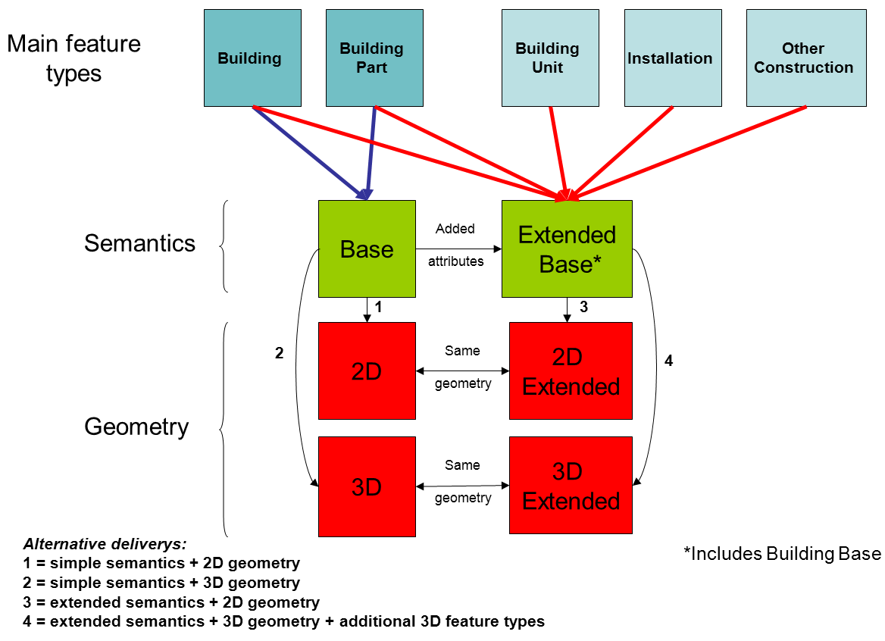
INSPIRE model BU: Profile approach
Elevated construction
Bridge
Tunnel
Protective structure
Implementing Rule
Chimney
Antenna
Solar panel
Appartment
Profile chosen by ELF

Slide 8
Data specification: levels of detail
INSPIRE Directive: The implementing rules shall be designed to ensure consistency between items of information which refer to the same object represented at different scales
    Data model is the same for all levels of details
    Information about LoD is given by metadata element: MD_Resolution
10K
20K
Not easy for users to identify which data sets may be combined together
2K
250K
5K
5K
1 K
200 K
25K
50K
100K
2K
2,5 K
10K
1M

Slide 9
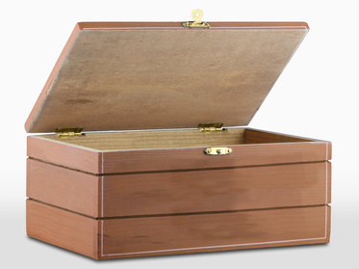
Data specification: levels of detail
ELF approach: 5 levels of detail
2K
20K
1 K
2,5K
10K
50K
250K
1M
5K
25K
Master level 0
To 5K
Master level 1 5K – 25K
Master level 2
25K- 100K
Regional level 100K -500K
Global level 0
500K- 1M

Slide 10
Data specification: levels of detail
Some themes are relevant only for some levels of detail
Theme | MASTER LoD0 | Master LoD1/2 | REGIONAL | GLOBAL
Cadastral Parcels (CP) | x
Addresses (AD) | x
Buildings (BU) | x | x | x
Administrative Units (AU) |  | x | x | x
Geographical Names (GN) | ? | x | x | x
Transport Networks (TN) |  | x | x | x
Hydrography (HY) |  | x | x | x
Land Cover (LC) |  | x | x | x
Elevation (EL) | ? | x | x | x
NOTE: buildings are included in Regional level as POI (Point of Interest)

Slide 11
Data transformation

Slide 12
Data transformation
First step in ELF project
  Transform data from (heterogeneous) national data specifications to the common ELF data specifications
    ELF specifications are based on INSPIRE ones
    Main purpose:
      Common data model
      Common Coordinate Reference System(s)
    But content will remain the national one
  Transformation method is up to each NMCA
Get interoperable (easy to combine) data among ELF partners

Slide 13
Data transformation
ELF benefits
  For data producers:
    Possible help from one ELF partner (Snowflake) with tool Go Publisher
      NMCA may use the tool (training offered)
      Snowflake may transform the data (matching rules to be provided by NMCA)
  For data users
    INSPIRE dead-lines for interoperability
      Annex I themes : 2017
      Annex II and III themes : 2020
    ELF objective : 2015
ELF data to be available before the INSPIRE dead-lines
Get interoperable data among ELF partners quicker and easier

Slide 14
Single access point

Slide 15
Single access point (download)
The scenario to be avoided
NMCA
National WFS
request
NMCA
National WFS
answer
NMCA
National WFS
A user wanting data on several countries should not be obliged to access several services.

Slide 16
Single access point (download)
The ELF scenario
NMCA
National WFS
Cascaded Service (WFS)
request
NMCA
National WFS
answer
NMCA
National WFS
The user is offered a single access point through the cascaded service.

Slide 17
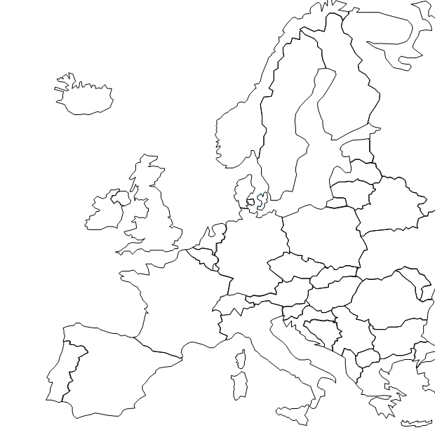
Single access point (download)
Step1: identify the countries concerned by the request
Cascaded service: distribute request
NMCA
National WFS
Cascaded Service
(WFS)
National WFS
NMCA
Request (feature type, bounding box)
National WFS
NMCA
(X1, Y1)
(X4, Y4)
NMCA
National WFS
(X2, Y2)
(X3, Y3)
National WFS
NMCA
Step 2: distribute the request to the concerned national WFS
Database of international boundaries

Slide 18
Single access point (download)
Cascaded service: aggregate answers
Step 1 : each national WFS provides data set according to the request
NMCA
National WFS
National WFS
NMCA
Cascaded Service
National WFS
NMCA
NMCA
National WFS
National WFS
NMCA
Step 2 :the cascaded service aggregates the national answers in one single feature collection

Slide 19
Extend geographic coverage

Slide 20
Extend the geographic coverage
ELF struggles to get more data
    From NMCAs not yet consortium members
      Join the Consortium
      Just provide data and services
    From other authorities
The objective is to get whole European coverage

Slide 21
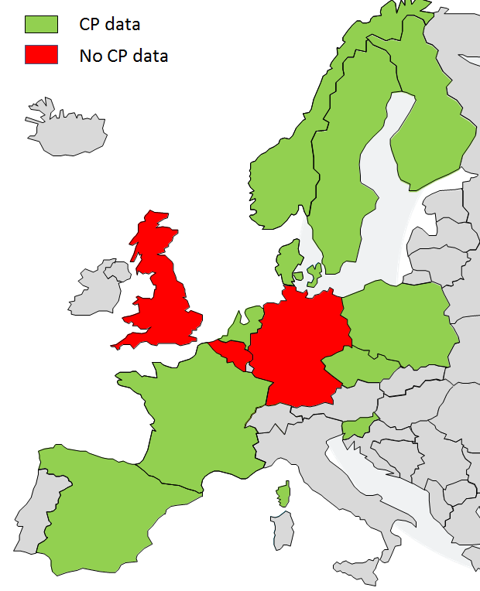
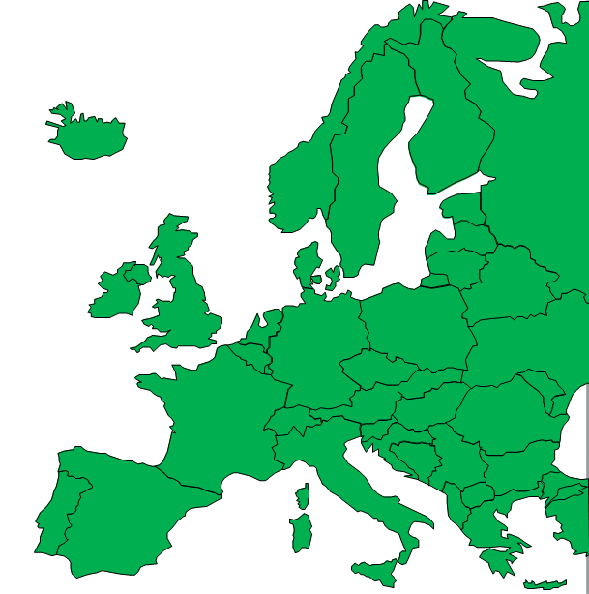
Extend the geographic coverage
Cadastral Parcels

Slide 22
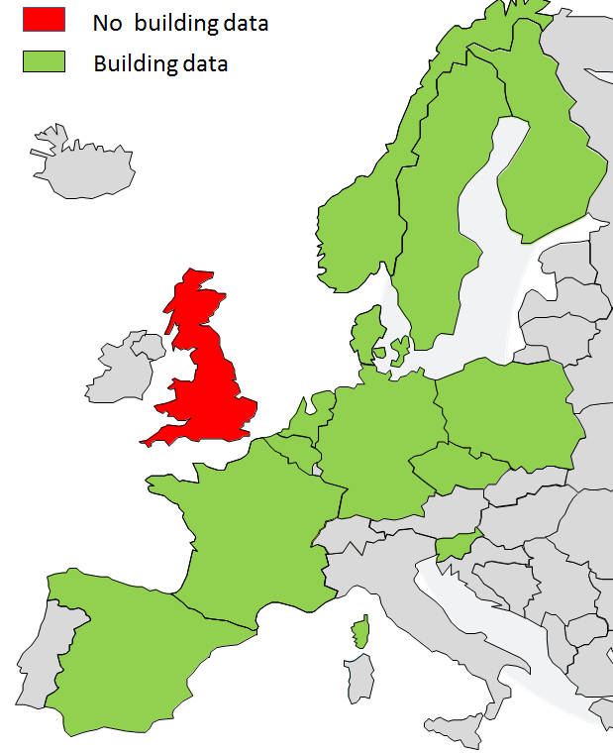
Extend the geographic coverage
Building
(core)

Slide 23
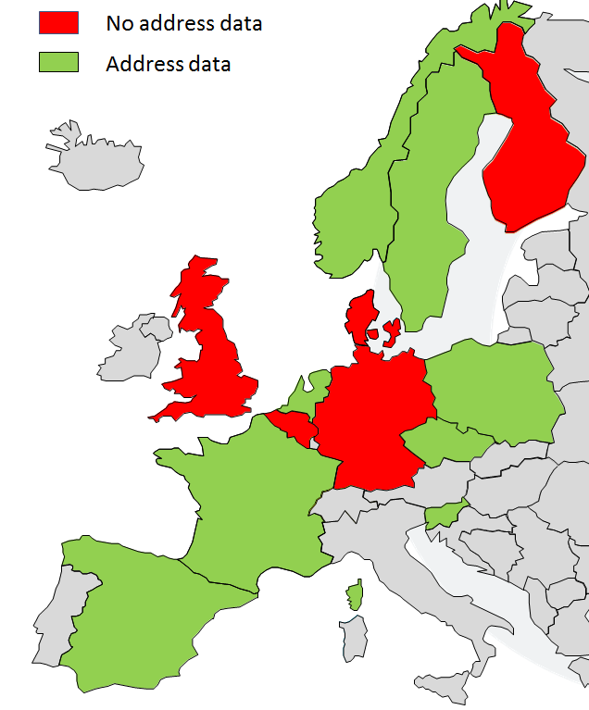
Extend the geographic coverage
Address

Slide 24
GeoLocator

Slide 25
GeoLocator
The indirect location may be a geographical name, an administrative unit, an address or a parcel code.
Direct geocoding
Request (indirect location)
GeoLocator
Set of centralised data sets
Answer (direct location)
The direct location will be a point defined by its coordinates (X1, Y1).
GN
AU
AD
CP

Slide 26
GeoLocator
The direct location will be a set of coordinates (X1, Y1).
Reverse geocoding
Request (direct location)
GeoLocator
Set of centralised data sets
Answer (indirect location)
The indirect location will be the closest address or parcel or geographical name or administrative unit
GN
AU
AD
CP

Slide 27
BaseMap

Slide 28
Main principles
BaseMap is a pyramid of digital maps displaying ELF based data, at different levels of zoom
    Content : themes EL, AU, BU, LC, HY, TN and GN
Zoom levels 144K to 40 M : EuroGeographics products
Zoom levels 2K to 72 K : (mainly) national data

Slide 29
BaseMap specifications: data model
BaseMap model is a simplification of ELF data model
  Simple, flat structure
  Only useful content for cartographic purposes
BaseMap model offers a common ELF-based terminology
Example: properties of theme TN attached as attributes to RailwayLink

Slide 30
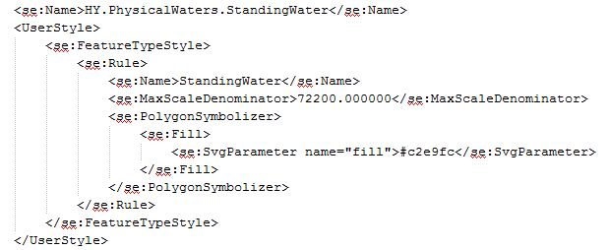
SLD (Style Layer Descripton)
BaseMap specifications: portrayal rules
Standardised way to document portrayal rules
Provides
    Layer name
    Layer source : feature type + OGC filter if relevant (selection on attribute values)
    Scale range
    Symbol to be applied

Slide 31
Portrayal rules: theme Buidings
Symbols for specific buildings
Zoom levels 2K and 4K
Zoom levels 9K to 36K

Slide 32
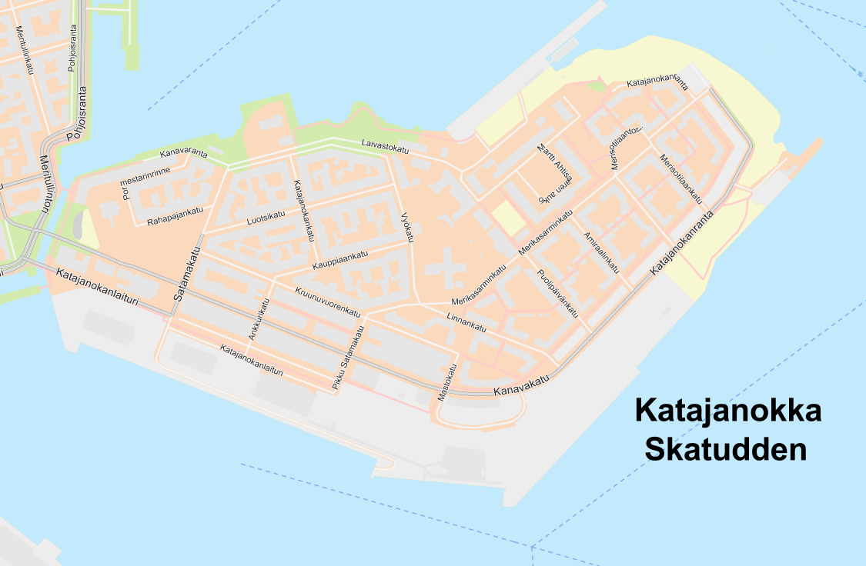
Portrayal rules: theme Transport (Road)
Example in urban area, with street names (4,5K)

Slide 33
ELF Cadastre

Slide 34
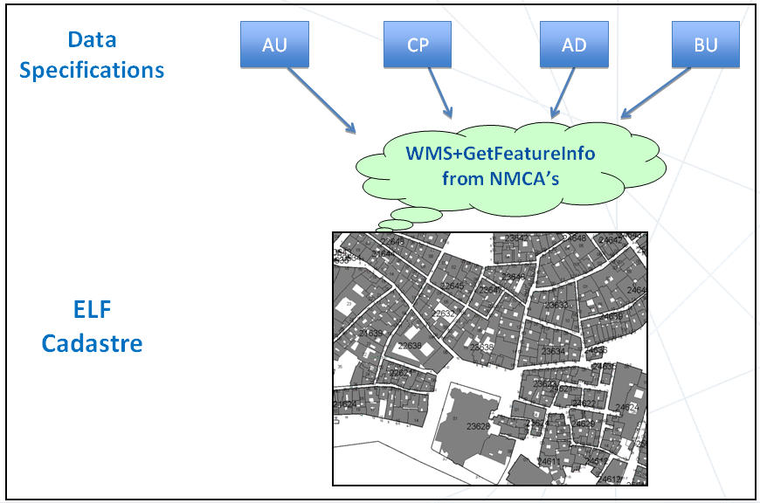
Principle
ELF Cadastre provides a harmonized view of cadastral parcels geometry combined with other basic information as administrative units, addresses and buildings.

Slide 35



identify
Objectives
view
WMS of data providers managed by cascade tools to have a harmonized and continuous vision of the whole territory.
search
Search Services to locate Cadastral parcels by its identifier or by its address (by use of GeoLocator)
Implementation of GetFeatureInfo to identify cadastral parcels, to know their attributes and to obtain all the associated information from the national cadastral agencies.

Slide 36
Architecture
INSPIRE
National data
National WMS with GetFeatureInfo and SLD support or ELF style
Centralized cascaded WMS with GetFeatureInfo and SLD support or ELF style
NMCA Data
AD,BU,CP,AU
National
WMS
Cascaded
WMS
NMCA Data
AD,BU,CP,AU
National
WMS

Slide 37
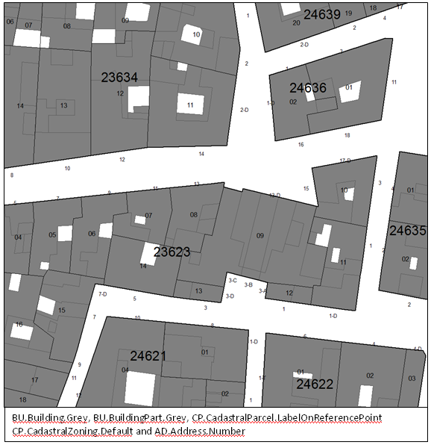
  Proposed Styles for ELF Cadastre
Based on INSPIRE portrayal rules
Improvement in readability

Slide 38
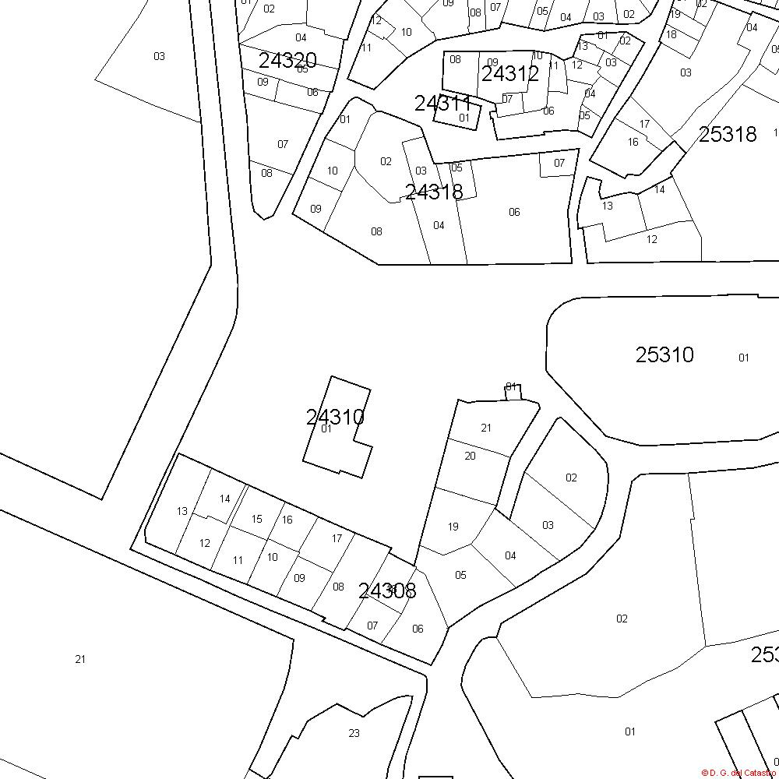
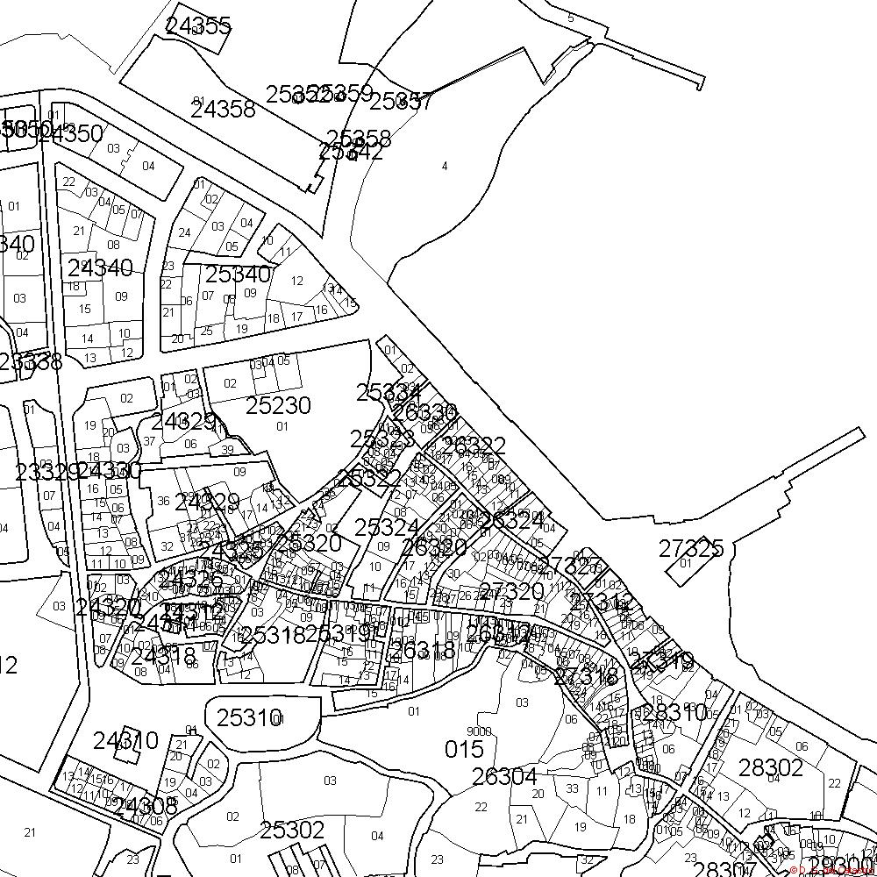
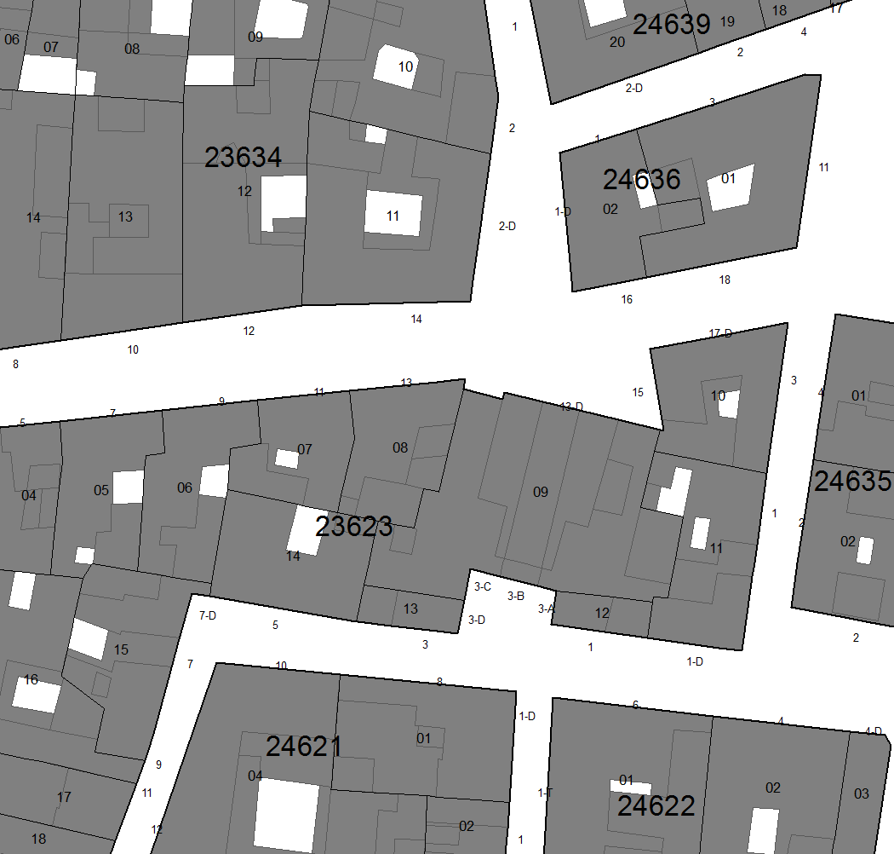
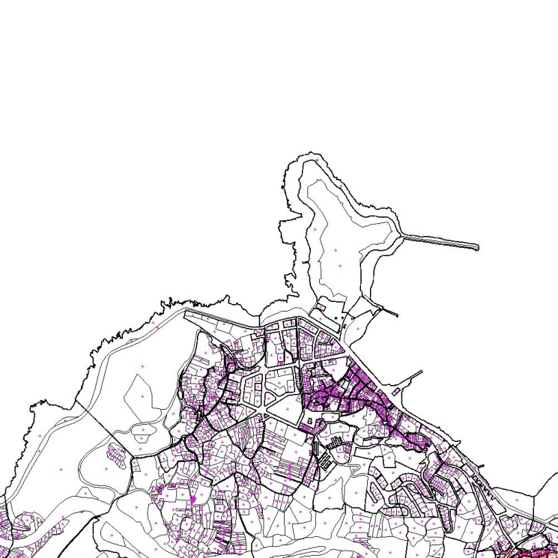
Examples

Slide 39
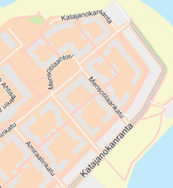

Use cases
Complement BaseMap
    Basemap : for LoD1 to Global
    ELF Cadastre : for LoD0
    Alone
    With BaseMap
Users may combine in client applications the BaseMap with the layers of ELF Cadastre
AB56
12
By adding cadastral parcels
By adding addresses

Slide 40
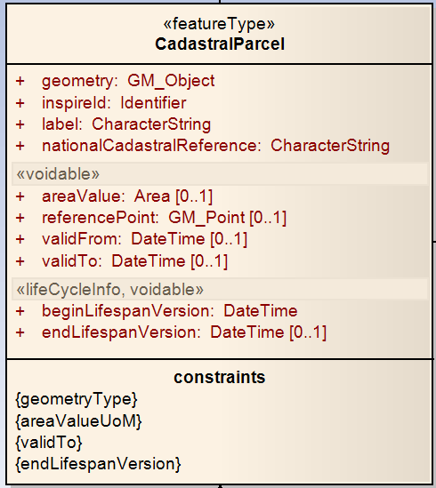
Use cases
Complement EULIS
    ELF Cadastre : provide the geographic information
    EULIS : provide the legal, fiscal information
Owners
First name | Last name | Birth date | …
Jean | Martin | 12/04/1980
EULIS
ELF
A key attribute to make link with cadastral registry

Slide 41
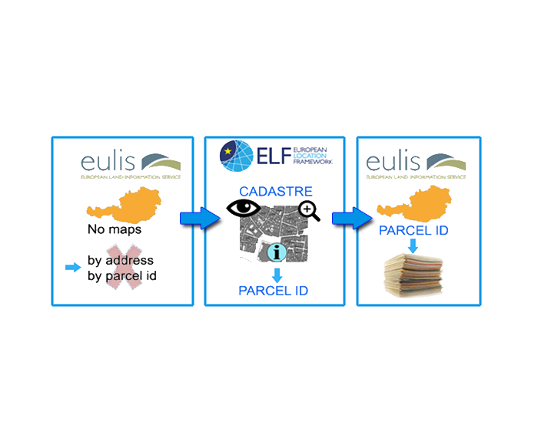
Example of use proposed by EULIS
No map in EULIS (for some countries)
User can find the parcel through the ELF cadastral map and get its identifier
With this identifier, user can find more information in EULIS (owner, …)

Slide 42
ELF applications

Slide 43
Principles
The ELF platform is open to application developers
    Existing (ELF partners)
      Emergency mapping
      Health statistics
      Real estate
      Insurance
    Future
      Objective: at least 30 more applications
      To be found with the ELF Awareness Tour (and other communication actions)

Slide 44
Description
 | Emergency mapping | Health statistics | Real estate | Insurance
Purpose | Make maps showing the situation before and after a disaster by using ELF data (instead of satellite images) | Enable users to make thematic maps using ELF data, statistics data and web service (TJS) | Provide reports about a given area to potential investors | Make risk assessment.
Themes | BU, TN, HY | AU, SU, HH | LU, LC, PS, NZ, TN CP, BU | BU
Others |  |  |  | GeoLocator (AD, GN,CP, AU)
All application developers very interested by ELF interoperable and easily accessible data.

Slide 45
ELF conclusions

Slide 46
What is expected from you
    Transform your data for INSPIRE
    Serve them through INSPIRE compliant download services (ATOM, WFS)
    Serve them through view services, applying the ELF portrayal rules
      SLD support (dynamic way)
      Using ELF style (static way)
Big expectations regarding themes AD, BU, CP
    Data is necessary for many applications (GeoLocator, ELF Cadastre, insurance, emergency, real estate, …)
    (hardly) no competitors on the market for cadastral parcels

